Slide 1
Mobile Node Pilot
Fernando Gros González
04-03-2013

Slide 2
Mobile Node - Qmp Presentation is licensed under a Creative Commons Attribution-ShareAlike 3.0 Unported License

Slide 3
Outline
Introduction
Mesh and Manet Networks
QMP
  Main features
  Quick deployments
  Addressing
  Modes
  Dynamic Routing Protocol
  BMX6
Mobile Node
Information sources
<número>

Slide 4
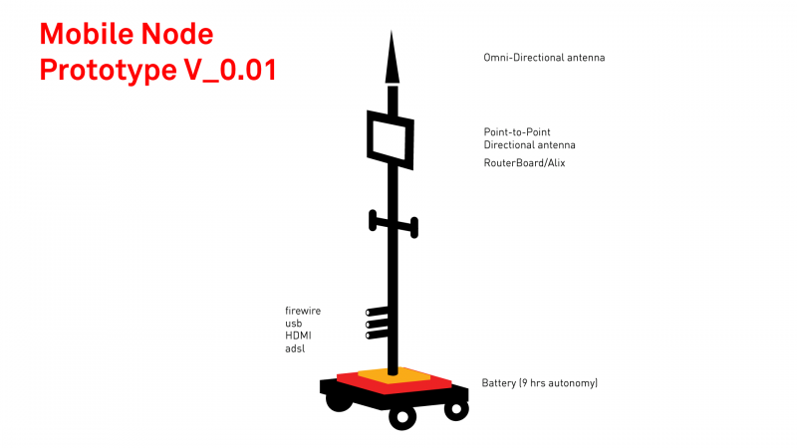
Introduction
The main idea within the Mobile Node Pilot is to create a free transmission workstation that can be used in the urban space and contributes to the digital mesh through other networks.
<número>

Slide 5
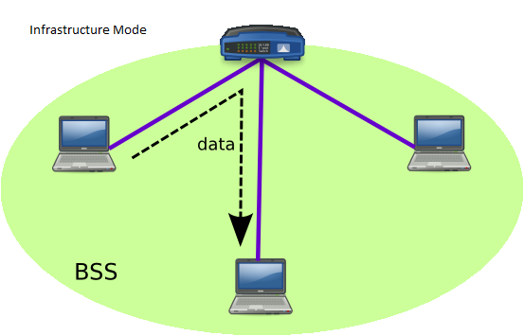
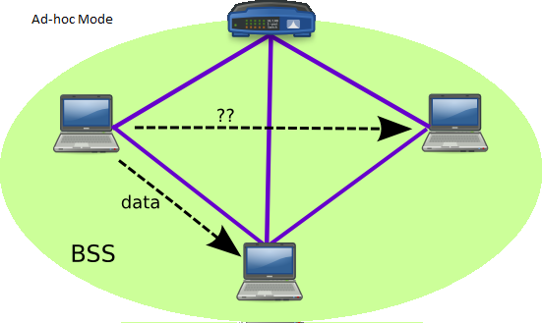
Mesh and Manet Networks (I)
  A mesh network is a network where all the participants are also routers. They are, normally, level 3 networks (Network layer) although they can also be link layer networks.
  Every node has to be connected, at least, to another node in the network, independently of the method (Cable, Wi-Fi, OF, etc.)
  It is not strictly necessary that this kind of networks use the Ad-hoc mode, they can use infrastructure mode too, although it is useless in many cases.
<número>

Slide 6
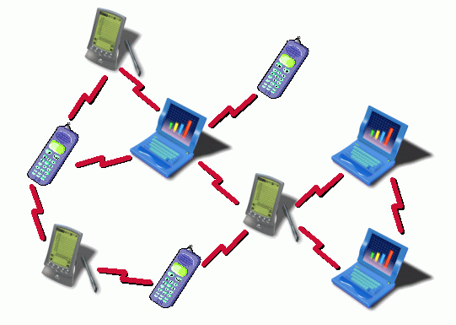
Mesh and Manet Networks (II)
When we have a mesh network which uses a wireless system to interconnect the nodes and is built in Ad-hoc mode, we talk about MANET (Mobile Ad-hoc Network).
So a MANET network:
  “ is a self-configuring infrastructureless network of mobile devices connected by wireless.” (Wikipedia)
In order to allow this self-configuring feature, we use Dynamic Routing protocols (DRP) which are specially optimized for MANET deployments.
<número>

Slide 7

QMP
Main Features
OpenWRT based
802.11a/b/g/n support
IPv6 native
IPv4 tunneled over IPv6
Auto configuration system
Web GUI to monitor and configure
Visualization tools (maps, graphs, etc.)
Automatic dynamic routing (zero-conf)
BGP (Border Gateway Protocol) support (half implemented)
Open Source
<número>

Slide 8
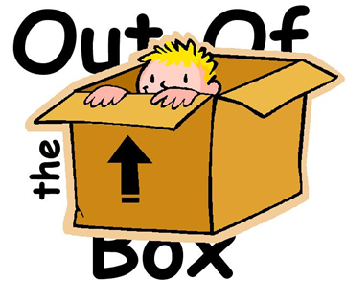
QMP
Quick Deployments
One of the scenarios QMP has been developed for is: Quick deployments.
Achieve the following requirements:
  The deployment must be performed as fast as possible.
  It must be able to be done by non-technical people.
  It must be possible in most situations.
<número>

Slide 9
QMP
Addressing
Qmp uses three different kind of IP addresses:
  IPv6 ULA: IPv6 private range to be used internally in the mesh. These IPs are used for the communication among the nodes in the mesh network, and so they are not neither valid nor routable outside.
  IPv6 RIPE: IPv6 public IPs range (6to6 tunneling). These are globally valid and routable.
  IPv4: IPv4 private range to connect with the final user (4to6 tunneling). They are assigned to the final users attached to a node in the mesh, when they transmit any packet that has to travel throughout the mesh it is encapsulated in an IPv6 packet (tunneling).
<número>

Slide 10
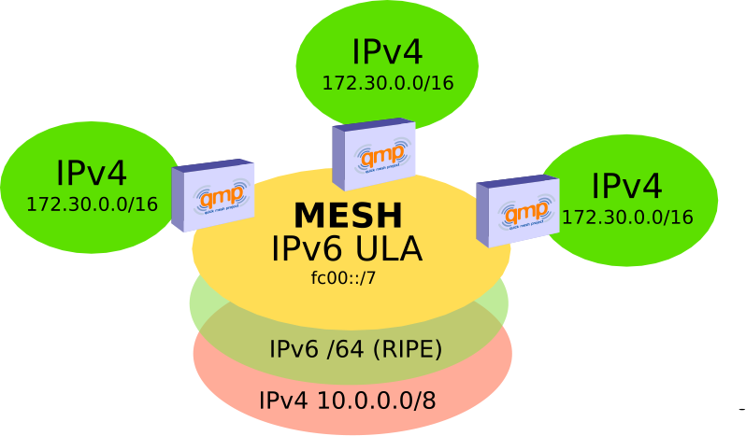
QMP

Slide 11
QMP
Modes
Roaming for fast deployments:
  All the access points in this mode will have the same IP and the same ESSID in order to allow users mobility, namely, they won’t lose the connection although they switch from an AP to another.
  Every AP implements a NAT and so, two users attached to different APs won’t have direct vision between them.
Community:
  Every node will have a randomly assigned IPs range and will announce this range through the mesh.
  There is not NAT, every user has direct vision with the others (1 hope away from the IPv4 network layer point of view), but mobility is not allowed (no roaming).
<número>

Slide 12
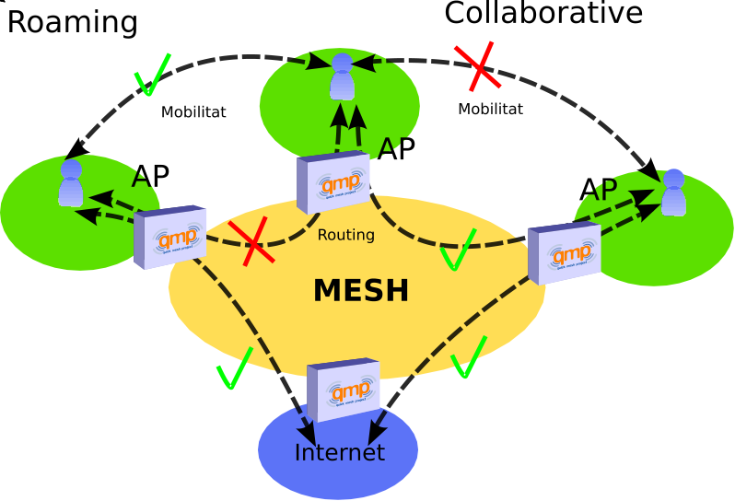
QMP

Slide 13


QMP
Dynamic Routing Protocol
The QMP firmware, uses the following protocols:
  BMX6 as the main DRP.
  OLSR6 as a backup DRP.
  Babel as a backup DRP but optional.
All three use IPv6 ULA to talk to other nodes and are isolated at the link layer (MAC) using VLANs.
<número>

Slide 14
QMP
BMX6
Pro-active: Uses UDP flooding to periodically send Originator Messages (OGM) and build a routing table.
Destination-sequenced, Distance-vector (DSDV): Every node just knows which neighbor is better to reach another, namely, they do not need to know the entire topology, just the best paths.
Does not use IP as node identifier, it uses global identifiers using SHA2 hashing.
<número>

Slide 15
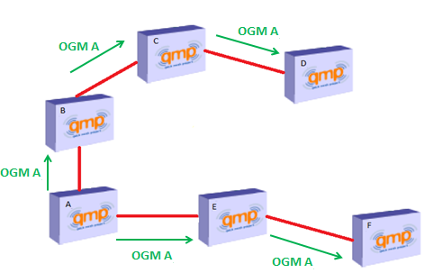
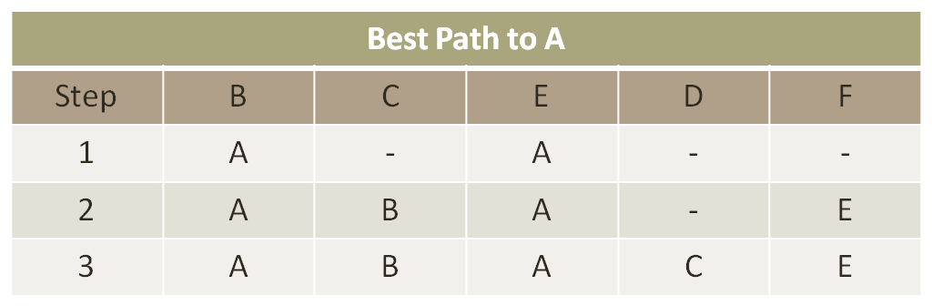

Slide 16
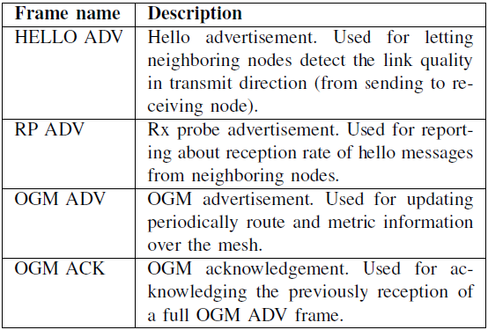
QMP

Slide 17
Mobile Node
The main goal of creating a node which has mobility is giving coverage to zones or event that are not covered with the existing fixed infrastructure. And so it has a lot of social implications, for citizens and cities:
  Giving Wi-FI access to people in a concert or any other event (indoor or outdoors).
  Allow people broadcast something taking place with their Smartphone (apps like bambuser) or using IP cameras.
  Giving coverage in a protest, moving the node along with the people.
  Etc!!
We always need a fixed infrastructure to be able to expand the mesh by adding this node. Cities like Barcelona are creating this kind of infrastructures.
<número>

Slide 18
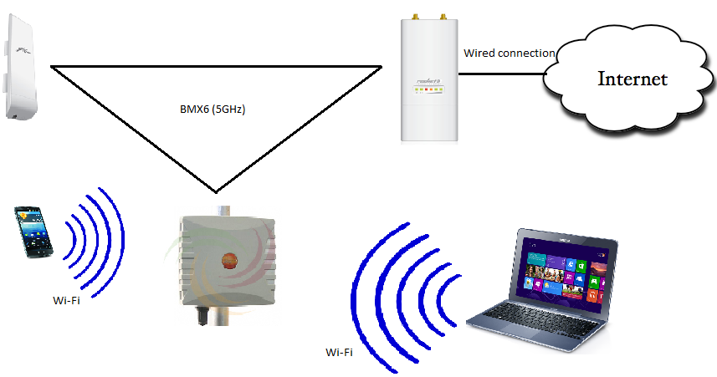
Mobile Node

Slide 19
Information Sources
Escrich, P. (2012, January). Quick deployment network using MANET. Retrieved March 4, 2013
Escrich, P. (2012, November 17). Xarxes Mesh. Curs Guifi.net 2012. Retrieved March 5, 2013
Mobile ad hoc network. (n.d.). In Wikipedia. Retrieved March 4, 2013, from http://en.wikipedia.org/wiki/Mobile_ad_hoc_network
Starting a Community. (2013, January 11). In Quick Mesh Project. Retrieved March 5, 2013, from http://qmp.cat/projects/qmp/wiki/Starting
Roaming-Community/Collaborative. (2012, June 26). In Quick Mesh Project. Retrieved March 5, 2013, from http://qmp.cat/projects/qmp/wiki/Roaming-Collaborative
QMP users mailing list
<número>

Slide 20
Thank you for your time!
<número>

